Slide 1


WiseMarket
Caleb Chen CAO, Yongxin TONG, Lei CHEN, H.V. Jagadish
The Hong Kong University of Science and Technology
University of Michigan
A New Paradigm for Managing Wisdom of Online Social Users

Slide 2

“Hey, there is gold in the data”
“Cool, let’s mine it out!”
from www.brainlesstales.com
Notes:
We all know there are tremendous bulks of useful information hidden in the big data.
We’ve been developing all kinds of techniques trying to grab the gold.
But we are missing something important:
The gold in data comes from the one

Slide 3
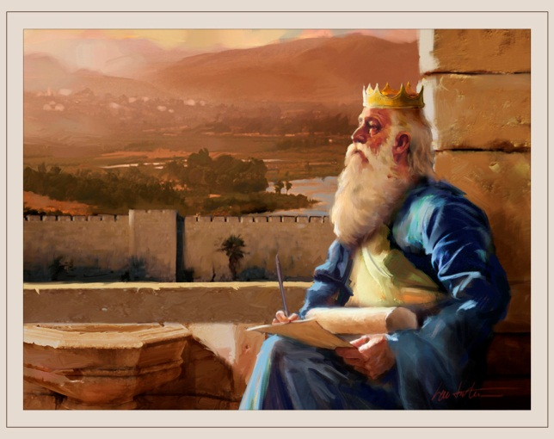
“Wait, did we miss something?”
“I don’t know. But King Solomon once said…”
“How much better is it to get wisdom than gold!”
-Proverbs 16:16
Notes:
The majority of the most precious information, i.e. the gold, cannot be easily found in data solely.
Human, instead of data, is now being considered as the unexploited source of information, knowledge, or simply “wisdom”.
Human is both the processor and the data source.

Slide 4
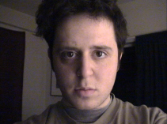
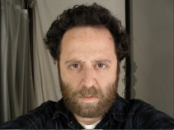
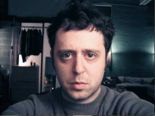
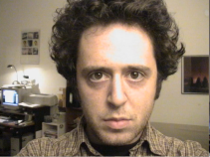
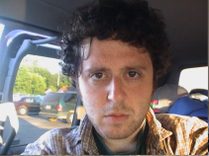
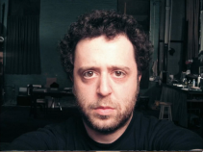
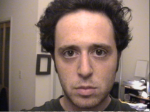
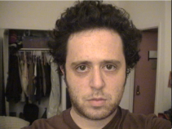
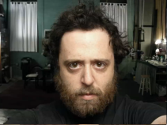
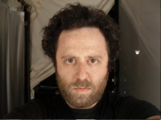
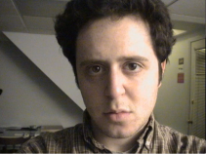
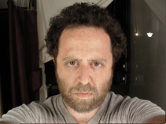
Why Human Wisdom?
Human-intrinsic Tasks
“Tony, I heard you are a very talented CS expert”
“Yes…?”
“You must be good at sorting “
“I suppose so…?”
“Great, help me to order my photos by age”
“Ok… (lucky there are only 12)”
Noah Kalina’s Daily Collection

Slide 5
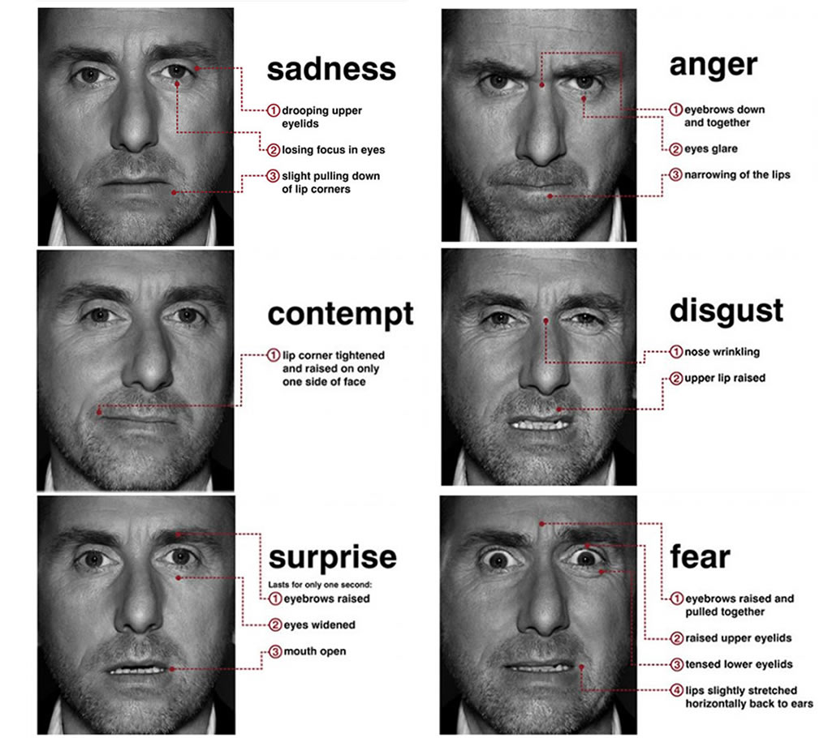
Why Human Wisdom?
Human-intrinsic Tasks
The tasks entail human instincts or natural knowledge,
The features are hard to be defined for computer programs by far
“Tony, could you cluster these photos according to their expressed feelings?”
Stills from “Lie to me”

Slide 6
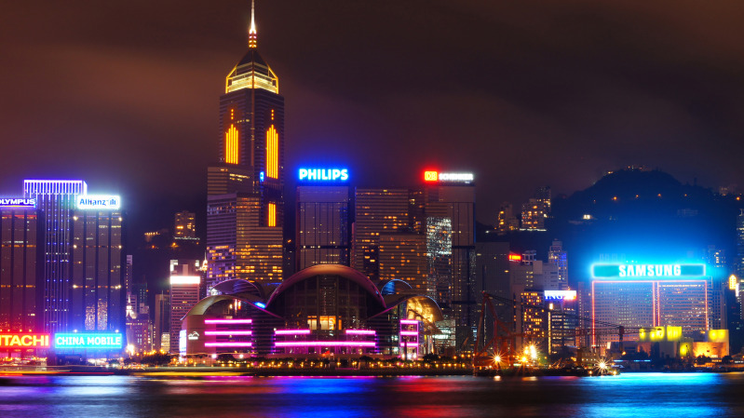
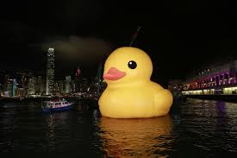
Why Human Wisdom?
Breaking Closed-world Assumption
Human introduces new knowledge
“Tony, could you ask the database which buildings have a red LED at Victoria Harbor?
“Well, I’d better ask the Giant Rubber Duck instead of any database”

Slide 7


Why Human Wisdom?
Latent Factors
Human make synthesized decision based on many factors
Some of them might be latent
“See the wrinkles?”
“Also the eyes, grow dimmer”
“That’s because of age, indeed.”

Slide 8
Why Human Wisdom?
Expenditures(v.s. Experts)
Crowds are much cheaper than Experts (on trivial human tasks)
Online crowds are always available and ready for tasks
Globalization & International Development
“participant pools are skewed towards poor users in developing countries (Wiki)”

Slide 9

However
Wisdom is within the human.
We need to dig it out, and manage them.
Well, it is difficult, because the humans are …
Notes:
1. We need a tool, or at least a framework to gauge, form and manage the wisdom within the human.

Slide 10
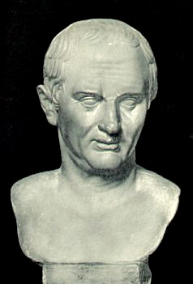
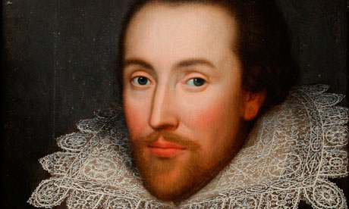
Humans
Erroneous
“To err is human”
—Marcus Tullius Cicero
Greedy
“…my more-having would be a sauce to make me hunger more”
—Macbeth act 4, sc. 3, Shakespeare

Slide 11
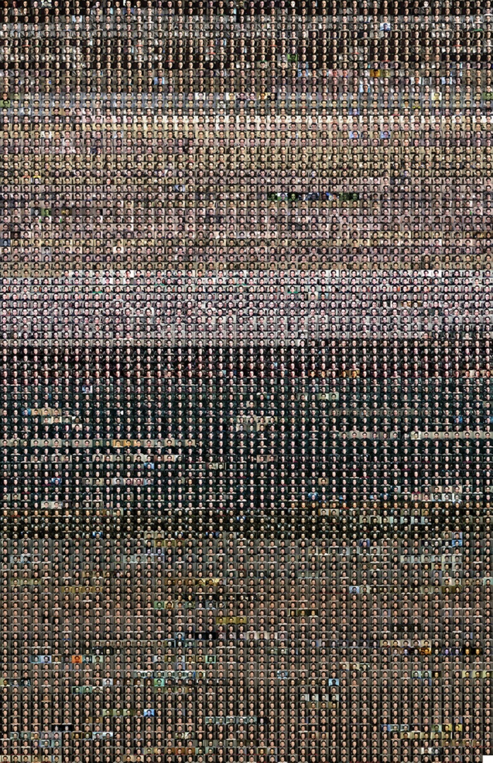
And…
During the Big Data Era
Tony, did you finish it?
Yep
Cool! I know I can trust the entire collection on you!
Ohhh…, we really need a CS expert, CrowdSourcing, not just Computer Science
Notes:
1. We need a tool, or at least a framework to gauge, form and manage the wisdom within the human.

Slide 12
Challenges
In general, humans
perform correctly according to a probability
and they(we) want to maximize their income
So how should we manage?
A Market.

Slide 13
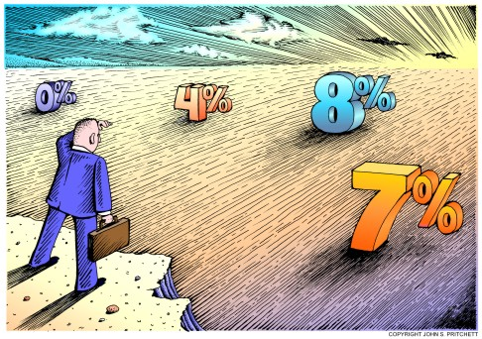

Market
Humans are investors
They have (partial)information
They invest to maximize income
A market consists of investors
Some of them win
Some of them lose
A market can
Make Decisions/Show Preference
Based on Majority Voting

Slide 14
WiseMarket
Only winning investors get rewards
Notes:
So we propose to use the market to organize online social users, who serve as investors;

Slide 15
Why WiseMarket?
Worriers in crowdsourcing, human computation services
Low Answers Quality
Spam Workers
Otiose Expenditure
Drawbacks in survey samplings, online review aggregation
Vulnerable Quality Guarantee
Uncontrolled Demographic
So How Does it Run?

Slide 16



How Does it Run?
Confidence’s Estimator
Wise Market Builder
MConf Calculator
Mcost Calculator
Wise Market User Interface
Task 5
Task 2
Task 4
Task 3
Task 6
Task 1
Choose the best investors to build a market

Slide 17
Outline
Running Example
Problem Definition
Building WiseMarket
Empirical Studies

Slide 18
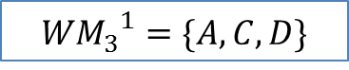

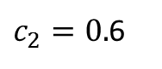
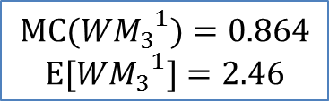
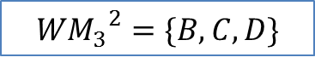
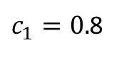
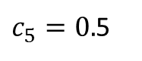

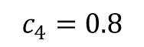

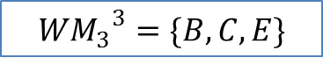
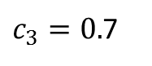


Running Example
Threshold $θ_{1}$ = 0.75
$${{WM}_{3}}^{2}=\{B,C,D\}$$
Threshold$θ_{2}$= 0.82
$$MC({{WM}_{3}}^{2})=0.788$$
$$E[{{WM}_{3}}^{2}]=2.36$$
A
B
$c_{1}=0.$8
C
$c_{2}=0.$6
D
$c_{3}=0.$7
E
$$c_{4}=0.8$$
$c_{5}=0.$5
$${{WM}_{3}}^{1}=\{A,C,D\}$$
$${{WM}_{3}}^{3}=\{B,C,E\}$$
$$MC({{WM}_{3}}^{1})=0.864$$
$$E[{{WM}_{3}}^{1}]=2.46$$
$$MC({{WM}_{3}}^{3})=0.65$$
$$E[{{WM}_{3}}^{3}]=2.27$$
Based on Majority Voting, to achieve an overall confidence of $θ$, how should we build a most economical market?

Slide 19
Running Example
Threshold $θ_{1}$ = 0.75
$${{WM}_{3}}^{2}=\{B,C,D\}$$
Threshold$θ_{2}$= 0.82
$$MC({{WM}_{3}}^{2})=0.788$$
$$E[{{WM}_{3}}^{2}]=2.36$$
A
B
$c_{1}=0.$8
C
$c_{2}=0.$6
D
$c_{3}=0.$7
E
$$c_{4}=0.8$$
$c_{5}=0.$5
$${{WM}_{3}}^{1}=\{A,C,D\}$$
$${{WM}_{3}}^{3}=\{B,C,E\}$$
$$MC({{WM}_{3}}^{1})=0.864$$
$$E[{{WM}_{3}}^{1}]=2.46$$
$$MC({{WM}_{3}}^{3})=0.65$$
$$E[{{WM}_{3}}^{3}]=2.27$$
“Economical” means minimum expected cost
Each winner is getting a unit-reward
Only winners get reward

Slide 20
Running Example
Threshold $θ_{1}$ = 0.75
$${{WM}_{3}}^{2}=\{B,C,D\}$$
Threshold$θ_{2}$= 0.82
$$MC({{WM}_{3}}^{2})=0.788$$
$$E[{{WM}_{3}}^{2}]=2.36$$
A
B
$c_{1}=0.$8
C
$c_{2}=0.$6
D
$c_{3}=0.$7
E
$$c_{4}=0.8$$
$c_{5}=0.$5
$${{WM}_{3}}^{1}=\{A,C,D\}$$
$${{WM}_{3}}^{3}=\{B,C,E\}$$
$$MC({{WM}_{3}}^{1})=0.864$$
$$E[{{WM}_{3}}^{1}]=2.46$$
$$MC({{WM}_{3}}^{3})=0.65$$
$$E[{{WM}_{3}}^{3}]=2.27$$
Each investor is associated with a confidence c
The market is measured according to Market Confidence MC

Slide 21
Running Example
Threshold $θ_{1}$ = 0.75
$${{WM}_{3}}^{2}=\{B,C,D\}$$
Threshold$θ_{2}$= 0.82
$$MC({{WM}_{3}}^{2})=0.788$$
$$E[{{WM}_{3}}^{2}]=2.36$$
A
B
$c_{1}=0.$8
C
$c_{2}=0.$6
D
$c_{3}=0.$7
E
$$c_{4}=0.8$$
$c_{5}=0.$5
$${{WM}_{3}}^{1}=\{A,C,D\}$$
$${{WM}_{3}}^{3}=\{B,C,E\}$$
$$MC({{WM}_{3}}^{1})=0.864$$
$$E[{{WM}_{3}}^{1}]=2.46$$
$$MC({{WM}_{3}}^{3})=0.65$$
$$E[{{WM}_{3}}^{3}]=2.27$$
If we choose {A,C,D}, the MC is 0.864 based on Majority Voting
The Cost is ?

Slide 22
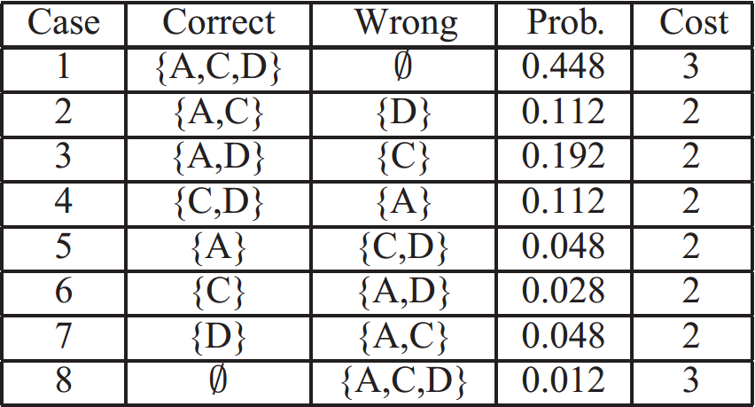

Running Example
$E\left[Cost\right]=2.46=3∙\sum{\left(Prob. of Case 1 and 8\right)+2∙\sum{(Prob. of Case 2 to 7)}}$

Slide 23

Running Example
Threshold $θ_{1}$ = 0.75
$${{WM}_{3}}^{2}=\{B,C,D\}$$
Threshold$θ_{2}$= 0.82
$$MC({{WM}_{3}}^{2})=0.788$$
$$E[{{WM}_{3}}^{2}]=2.36$$
A
B
$c_{1}=0.$8
C
$c_{2}=0.$6
D
$c_{3}=0.$7
E
$$c_{4}=0.8$$
$c_{5}=0.$5
$${{WM}_{3}}^{1}=\{A,C,D\}$$
$${{WM}_{3}}^{3}=\{B,C,E\}$$
$$MC({{WM}_{3}}^{1})=0.864$$
$$E[{{WM}_{3}}^{1}]=2.46$$
$$MC({{WM}_{3}}^{3})=0.65$$
$$E[{{WM}_{3}}^{3}]=2.27$$
How about {B,C,D}?
The expected Cost is lower(2.36), but the market confidence disagrees with the threshold $θ_{2}=0.82$

Slide 24
Running Example
Threshold $θ_{1}$ = 0.75
$${{WM}_{3}}^{2}=\{B,C,D\}$$
Threshold$θ_{2}$= 0.82
$$MC({{WM}_{3}}^{2})=0.788$$
$$E[{{WM}_{3}}^{2}]=2.36$$
A
B
$c_{1}=0.$8
C
$c_{2}=0.$6
D
$c_{3}=0.$7
E
$$c_{4}=0.8$$
$c_{5}=0.$5
$${{WM}_{3}}^{1}=\{A,C,D\}$$
$${{WM}_{3}}^{3}=\{B,C,E\}$$
$$MC({{WM}_{3}}^{1})=0.864$$
$$E[{{WM}_{3}}^{1}]=2.46$$
$$MC({{WM}_{3}}^{3})=0.65$$
$$E[{{WM}_{3}}^{3}]=2.27$$
How about others?
There are too many possible combinations, we need better solutions

Slide 25
Outline
Running Example
Problem Definition
Building WiseMarket
Empirical Studies

Slide 26
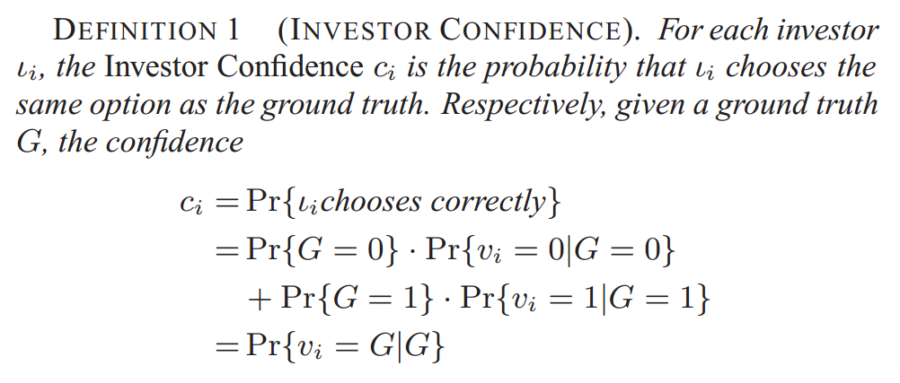

Problem Definition
Investors
$v_{i}$ is the actual invest choice of the investor
The two options are assumed to have equal prior preference

Slide 27
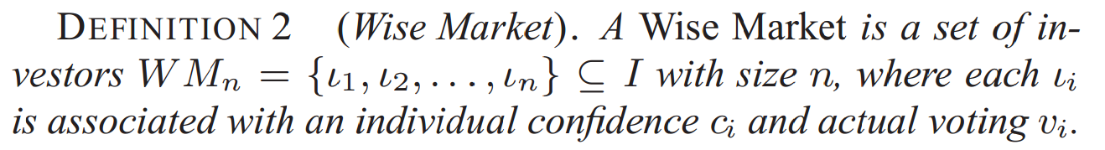
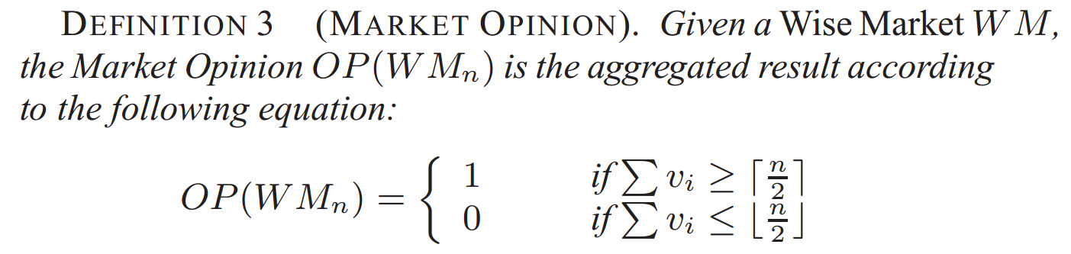
Problem Definition
Wise Market
Market Opinion
The market size should be ODD to feature Majority Voting

Slide 28
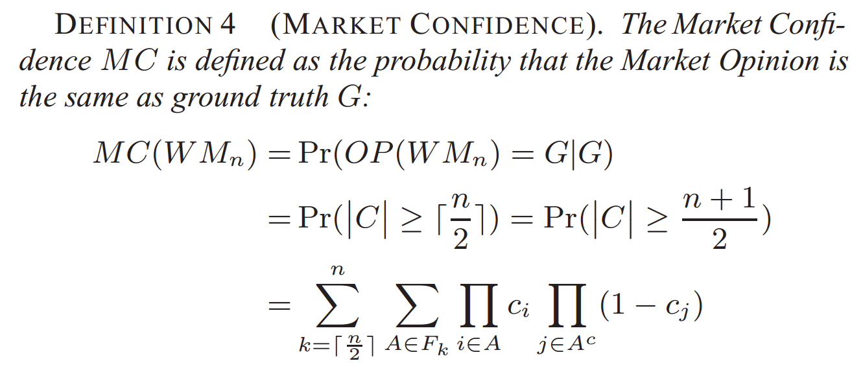
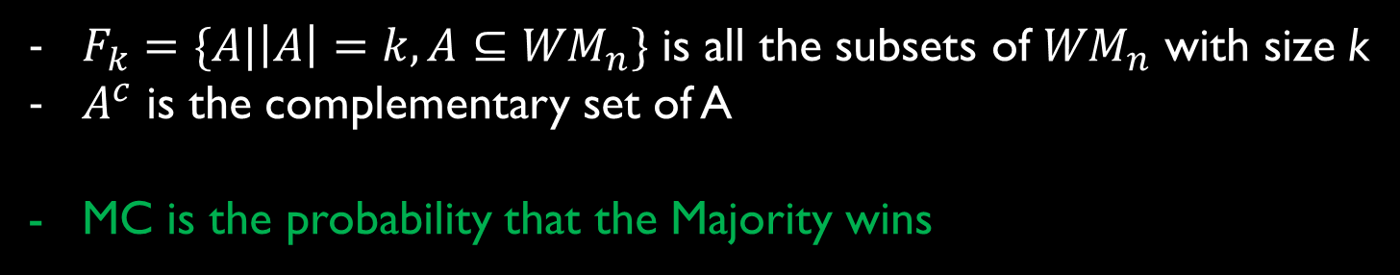
Problem Definition
Market Confidence
$F_{k}=\{A|\left|A\right|=k,A⊆{WM}_{n}\}$ is all the subsets of ${WM}_{n}$ with size k
$A^{c}$ is the complementary set of A
MC is the probability that the Majority wins

Slide 29
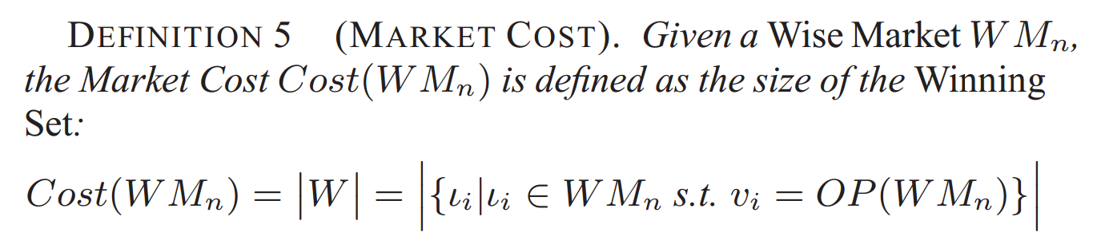
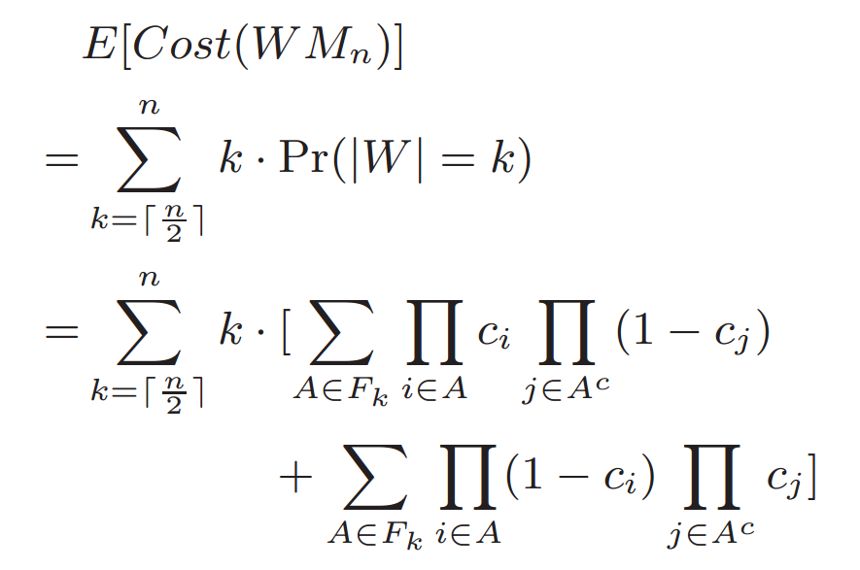
Problem Definition
Market Cost
Expected Market Cost
The lower the expected cost, the more economical the market

Slide 30
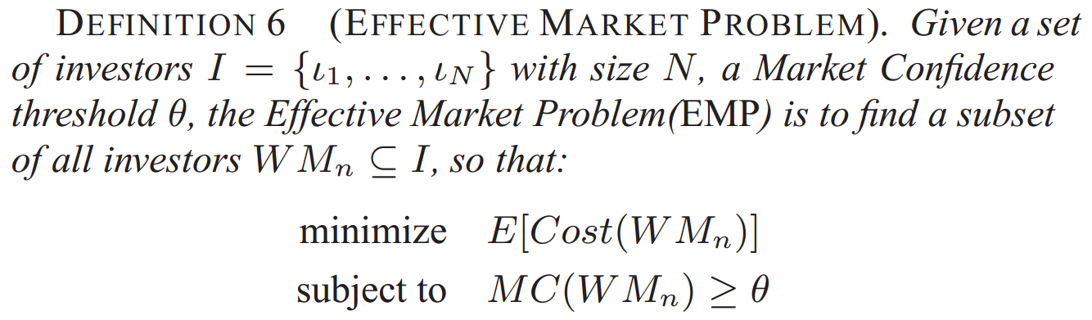
Problem Definition
Effective Market Problem
A market BUILDER for tasks holders

Slide 31
Outline
Running Example
Problem Definition
Building WiseMarket
Empirical Studies
Market Confidence
Market Cost
Market Building
Exact
Quality
Approximate
Efficiency
Notes:
Mainly we have three sub steps to build up a WiseMarket
For each block, we propose both exact and approximation algorithms as practical tradeoff for different users.

Slide 32
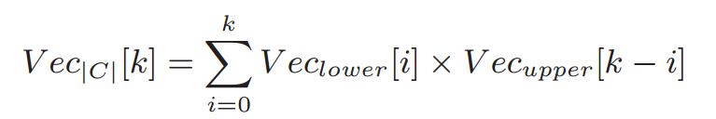
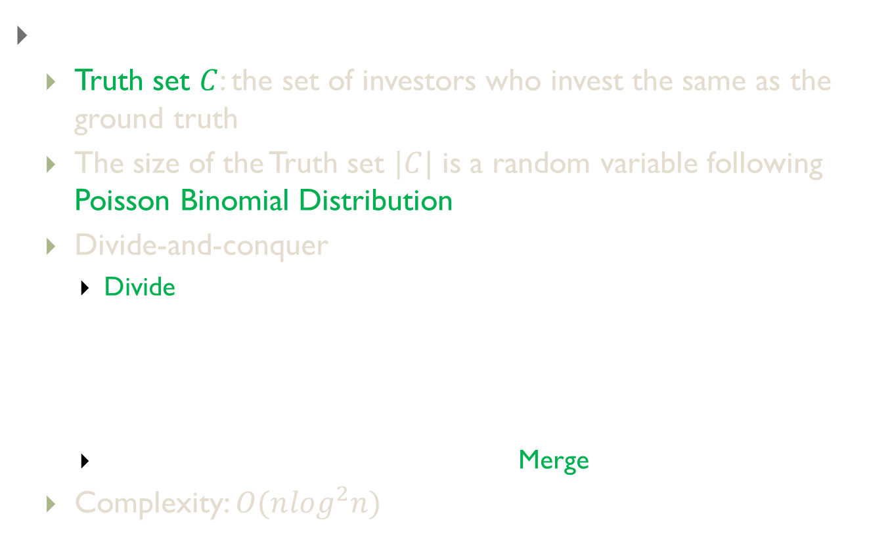
Market Confidence
Exact Calculation
Truth set $C$: the set of investors who invest the same as the ground truth
The size of the Truth set $|C|$ is a random variable following Poisson Binomial Distribution
Divide-and-conquer
Divide large market into two
Using FFT to speedup convolution in Merge phase
Complexity: $O(n\log^{2}n)$

Slide 33
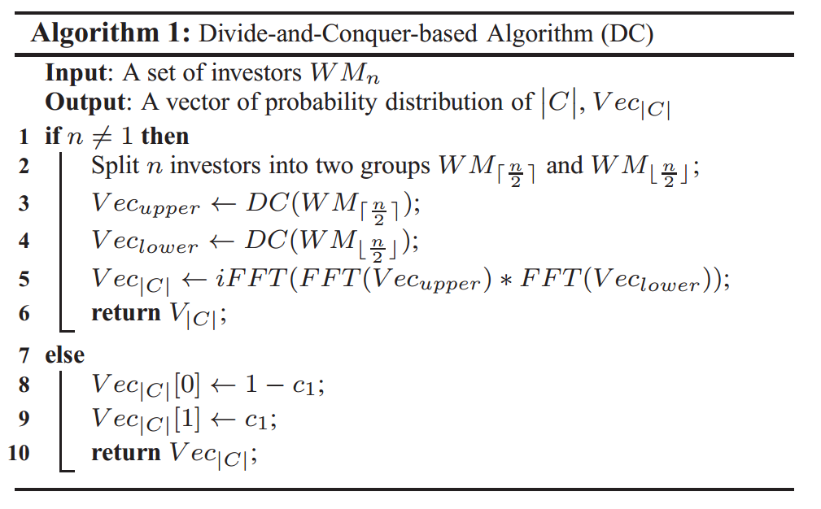
Market Confidence
Exact Calculation

Slide 34
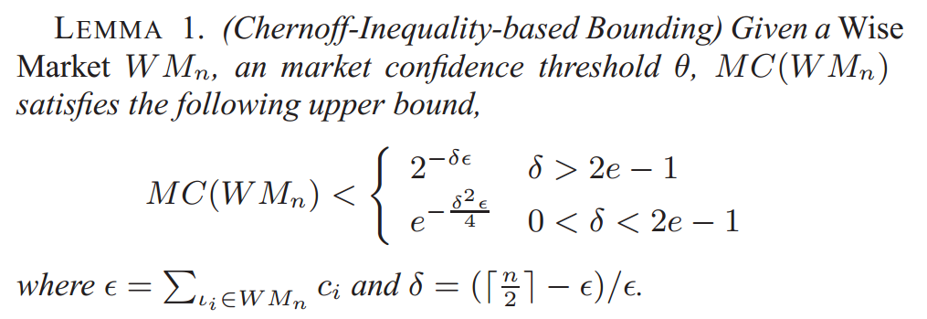

Market Confidence
A Chernoff-Inequality-based Bounding
This gives us an upper bound of the market confidence
Complexity: $O(n)$

Slide 35
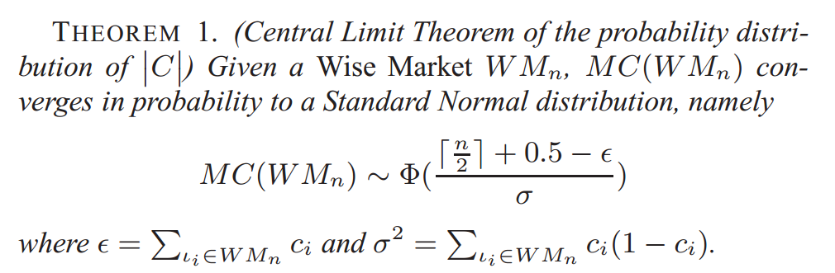

Market Confidence
Approximation Calculation
Based on Central-Limit-Theorem
Accurate especially when the population of candidate investor is huge
Store the Standard Normal Distribution via hashing function
Complexity: $O\left(n\right)$

Slide 36
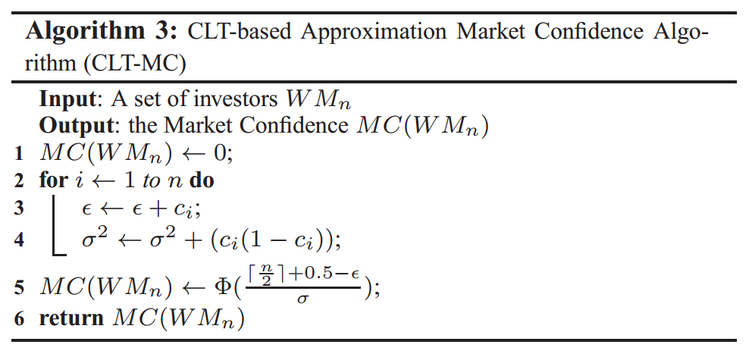
Market Confidence
Approximation Calculation
Based on Central-Limit-Theorem

Slide 37
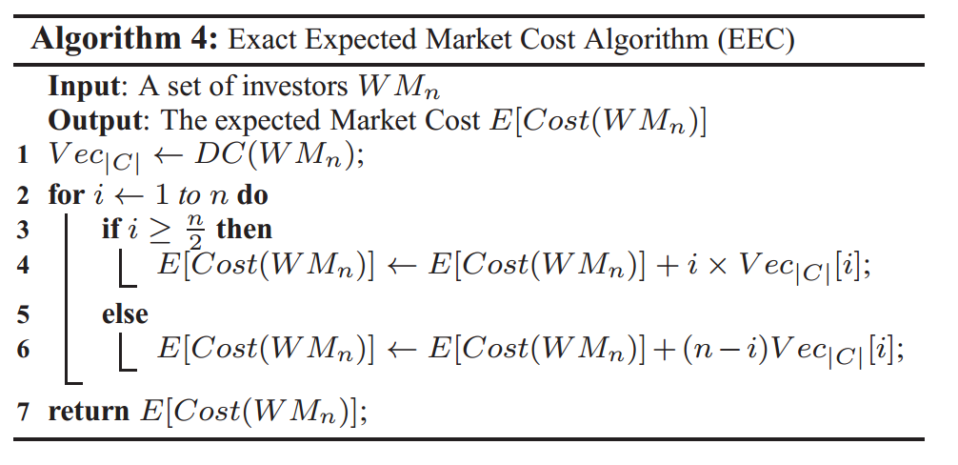
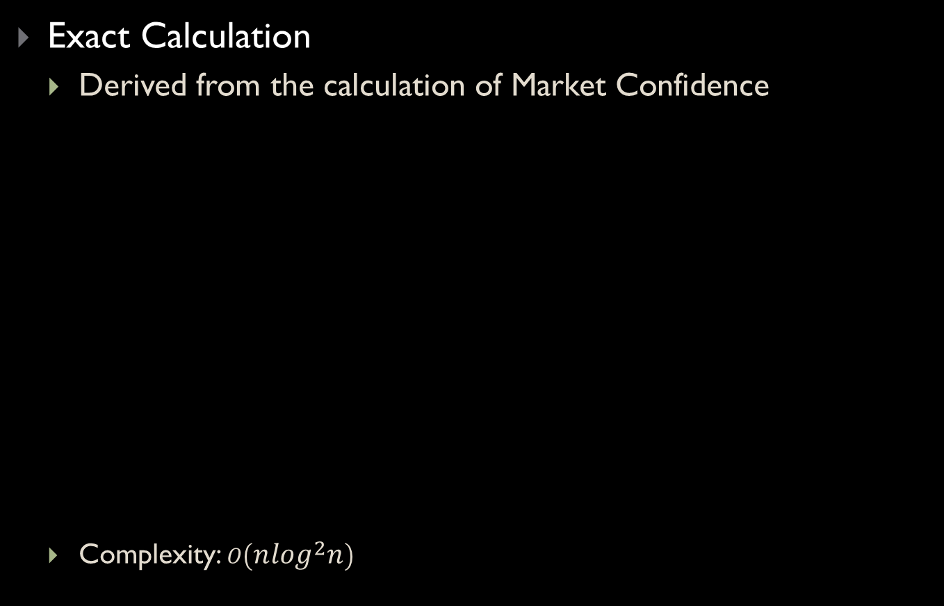
Market Cost
Exact Calculation
Derived from the calculation of Market Confidence
Complexity: $O\left(n\log^{2}n\right)$

Slide 38
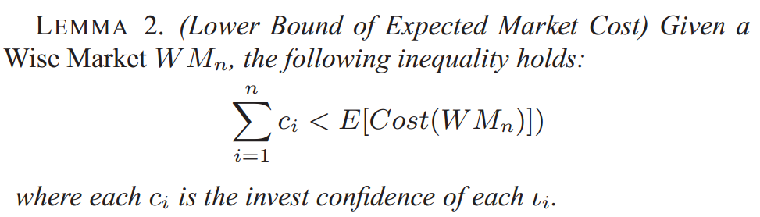
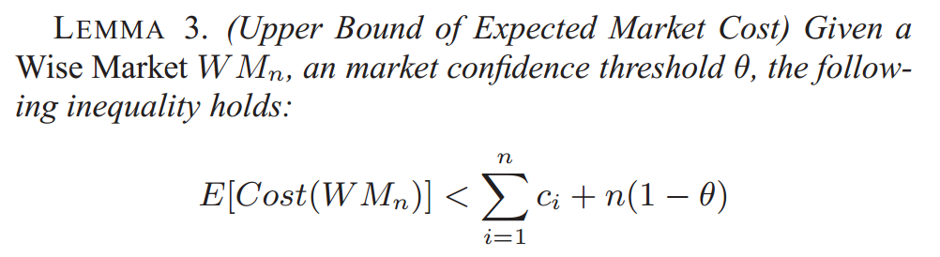
Market Cost
Approximate Calculation
Lower Bound
Upper Bound
Notes:
1. The approximate Calculation is built based on a pair of lower and upper bounds of the expected value

Slide 39
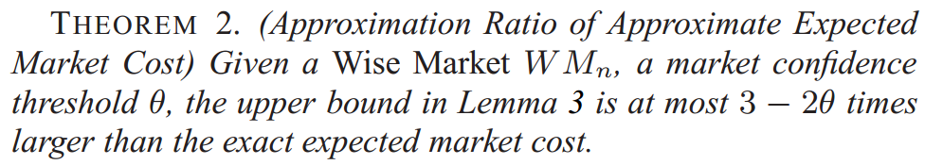
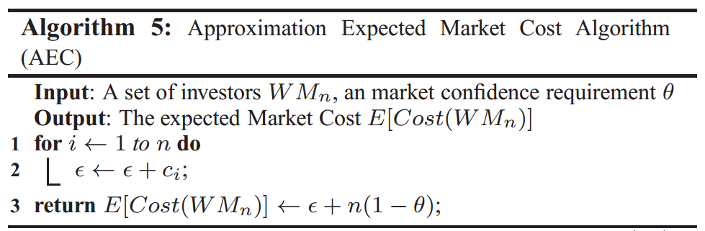

Market Cost
Approximate Calculation
So we can build algorithm with approximate ratio $(3−2θ)$
Complexity: $O(n)$

Slide 40

Market Building
Early Termination
Chernoff Bound as pruning Condition
Using MergeRank to generate combination in sequence

Slide 41

Market Building
Overall Algorithm

Slide 42
Outline
Running Example
Problem Definition
Building WiseMarket
Empirical Studies

Slide 43
Empirical Studies
Datasets
Synthetic
Normal Distribution
Zipf Distribution
Real Data – Infer from Weibo data
PageRank-based Inferring
Sentimental Analysis Benchmark Inferring
Environment
2 Intel(R) Core(TM) 2.13GHz
2G Memory
Microsoft 64-bit Win 7

Slide 44


Empirical Studies
Traits of MC and Cost
Notes:
Mean=0.5 is the turning point of better market size;(from fig (a))
MC converges quickly according to the size;(from fig (c))
In Zipf distribution, most investors are unreliable, the market tends to be small. (from fig(d))

Slide 45

Empirical Studies
Algorithms for calculating MC and Cost
Notes:
Complexity analysis holds, O(nlogn)for red line, O(n) for blue, O(1) for black(axis); (from fig e)
Approximate algorithms performs to the expectation on efficiency; from fig e to fig h
Approximate algorithms performs to the expectation on effectiveness, the gap between red and black shows the approximate ratio; from fig i to fig l

Slide 46


Empirical Studies
On the Approximation algorithm for Cost
Lower bound of the Cost have condition: the Confidence must satisfy the threshold(Theorem 2)
EMP Algorithm
Notes:
The lower bound must satisfy the condition in Theorem 2; (the dotted line in fig b is thus invalid)
The EMP can find satisfactory markets;(fig c and d)

Slide 47

Thank You
Q & A

